Slide 1



PVs at Ekurhuleni
When life gives you lemons, make lemonade!
Mark Wilson
Head of Department: Energy, Ekurhuleni, Mark.Wilson@ekurhuleni.gov.za
Greg Robinson
Managing Director, Xtensible Solutions, grobinson@Xtensible.net

Slide 2
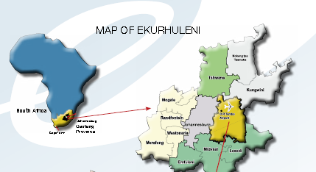
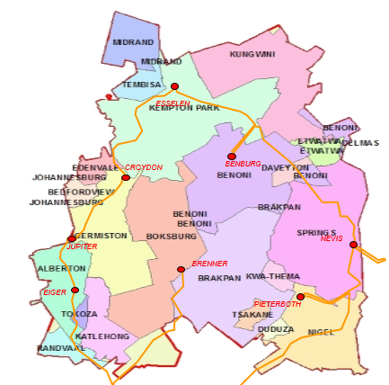
A Bit About Us
The City of Ekurhuleni is one of the South African Metropoles
The word e-kur-hu-leni means “place of peace”
In terms of electrical size, it eclipses the City of Johannesburg
The City has a population of about 2,8 million

Slide 3



Arriving in South Africa, you will land safely at The OR Tambo International airport
Situated within the boundaries of the City of Ekurhuleni

Slide 4

“EKURHULENI” MEANS PLACE OF PEACE…
BUT WE HAVE OUR CHALLENGES…

Slide 5


Slide 6
CHALLENGES IN RELATION TO ENERGY
The City has a sizable backlog in electricity supply connections
Formal households awaiting connections total 120 000
Informal households awaiting connections add a further 120 000
  Many of these informal houses are in areas where soil conditions prevent development, e.g. dolomitic ground
  Some informal housing structures were built on private land, meaning that they will have to be relocated
  The ad hoc layout of an informal settlement is not conducive for safe and effective grid installation
  By the very nature of these settlements, the electricity supplier will need to pay special attention to preventing grid interference (theft, etc.)
  A National tariff structure exists to assist vulnerable customers, and the low levels of this tariff create sustainability difficulties for some distributors
  The Eskom generation capacity is constrained and will remain so for the near future
  Off-grid solar power packs are distributed by the City, with a small PV panel, a battery pack, LED lighting and a cellular phone charger
  This alleviates the energy pressure somewhat, but more is needed, so that basic requirements such as keeping food cold, and watching television can be met.

Slide 7




Informal settlements in South Africa

Slide 8
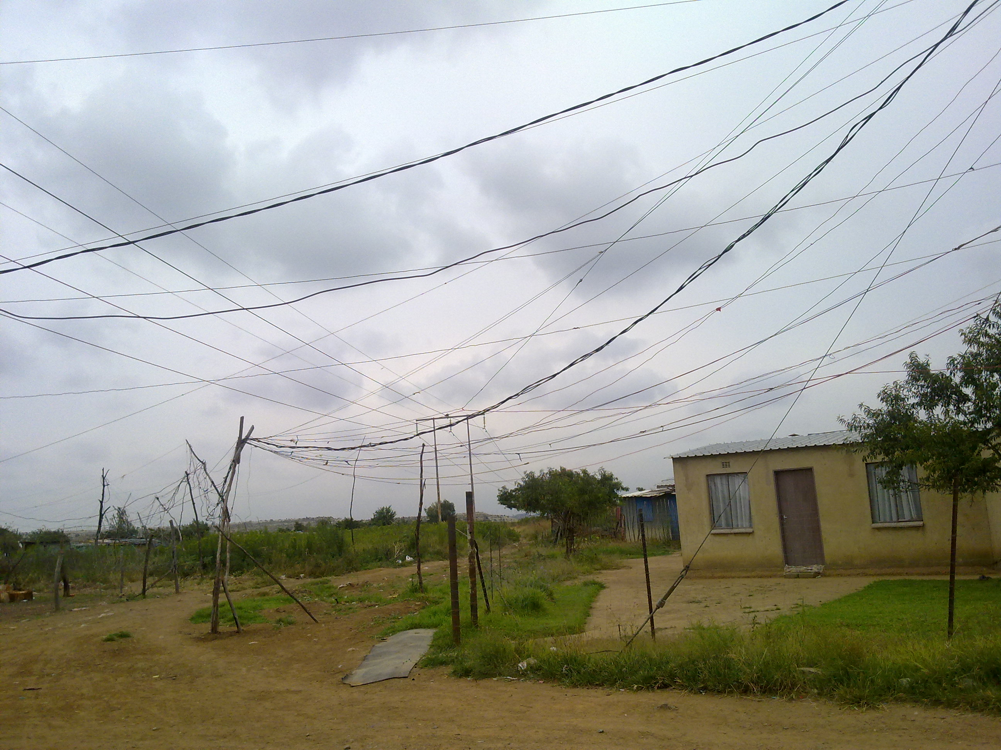
ILLEGAL CONNECTIONS
ELECTRICITY NETWORK AND METERING INTERFERENCE
JULY 2014

Slide 9
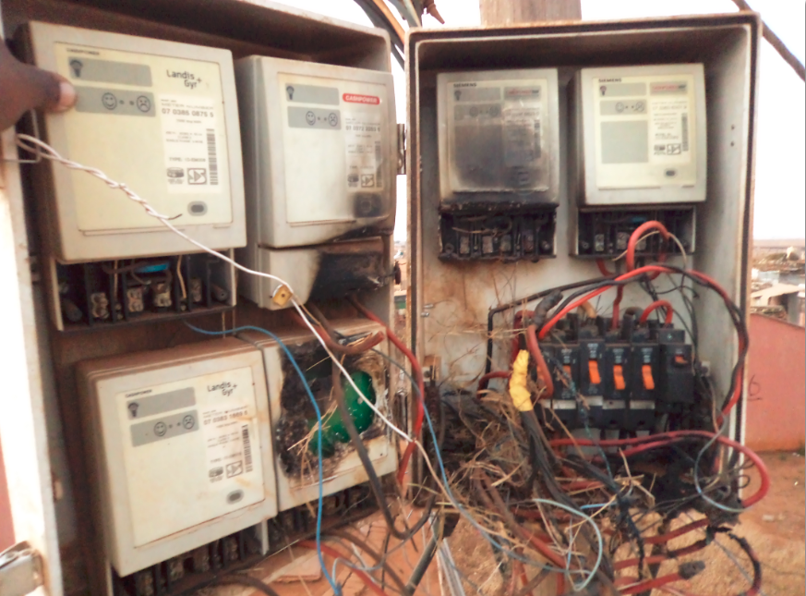
VANDALISM AND THEFT
The photo was taken in Villa Liza x2, Boksburg
6 prepayment meters in one pole top box, all bypassed, at least 4 meters destroyed
The uncontrolled electricity consumption destroys transformer and cable insulation, even to the point that they catch fire

Slide 10

ENVISAGED SOLUTION For Smaller Customers
The challenges highlighted could be largely resolved by opting for an off-grid solar solution:
  Solar energy is the only viable solution in Ekurhuleni, given low wind conditions and the topography
  Provided that the capital input costs are within reason, the solar option could resolve all of the matters mentioned previously

Slide 11
PV For Larger Customers Offers a Few Challenges - Business
Distributed renewable generation is increasingly eroding EMM’s energy revenue stream and power quality
  PVs are being attached to the system on an ad hoc basis
  Microgrids introduce the question of franchise rights and the definition of a utility
  EMM’s electrical network is be used as an uninterruptible power supply
  Costs for dealing with PV and microgrid problems are indirectly being pushed on to customers not receiving benefits

Slide 12
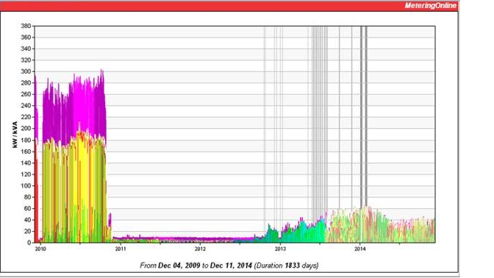
Business Challenge –Paying for Infrastructure With Reduced Consumption
Reduced Consumption by Customer After Solar Installation.
Now who is paying for the electrical network infrastructure that is still required by this customer?

Slide 13

PV For Larger Customers Offers a Few Challenges - Technical
Power System planning (steady-state and dynamics)
Accurate forecasting of both generation resources & load
Voltage stability (managing reactive power)
Power balancing – sensitivity to the intermittent nature of renewable load, and matching base-load and peak-load generation, considering generator ramp rates and minimizing start-stop operation of peak-load generators.
Overcoming the power balancing “reaction time mismatch” with energy storage solutions.
EMM is having to maintain and operate the infrastructure to provide a reliable power supply
    Relaying, reclosers, conductors and transformers to accommodate two-way power flows

Slide 14
PV Energy Contribution Over 4 Days
Ekurhuleni System Load Peaks at Varying Times Between 9 AM and 6 PM

Slide 15


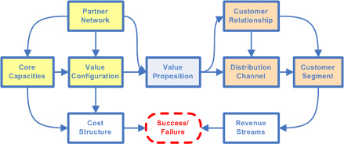
Being Proactive with PV
The American Council on Renewable Energy’s 2014 Industry Review: "Evolving Business Models for Renewable Energy:”
  Creates disruptive change for electric power utilities
  Provides customers with alternatives to their utility
Utilities must rethink how these distributed resources will affect their operations, planning, strategy and customer engagement. They must take proactive steps to:
  Renew the regulatory compact
  Market, test, or pilot alternative resources
  Define adjustments to the operating model
  Define adjustments to the business model

Slide 16
PV’s Impact on Business
While exact timing is difficult to predict, it is evident that Ekurhuleni will be dealing with industry disruptive technologies
Ekurhuleni needs to be prepared to incrementally revise its energy sales business model and ensure it is supported by a flexible automation infrastructure
The highest priority is the implementation of advanced metering infrastructure (AMI) as this would help Ekurhuleni to:
  Have quicker response times for outages and other network problems
  Enable the utilization of time-of-use and dynamic tariffs to provide consumers with financial incentives to reduce their electricity usage during peak demand times
  Improve system reliability
  Provide extensive data that can be used for planning purposes and to increase system efficiencies
AMI needs to be implemented within a 20 year Smart Grid context
  Implement AMI within a Smart Grid Integration Framework (SGIF) that is “future proof”
    open industry standards (with particular attention paid to data management)
  Give Ekurhuleni and its stakeholder information key to optimally adjust its business model

Slide 17
What is a Smart Grid ?
Dispatchable Energy Storage
(Pilot Project Shown)
Photovoltaic Solar
Smart Meter
Water Meter
Represents the first phase (pilot) scope
Additional SG components will include SCADA, Distribution Automation, Microgrids, etc
Smart Grid Communication
Load Control
Outage Events
Premise Area Network (PAN)

Slide 18
Smart Grid Planning with PV
EMM developed an industry standards-based Smart Grid Roadmap in 2014
  First step: piloting not only AMI capabilities, but also tariffs that can support a sustainable business model
  Tariffs must be mutually beneficial to the municipality and its stakeholders
  For PV customers with significant storage capabilities, there is the opportunity for them to work collaboratively with EMM
    Their inverter capabilities can be integrated into system operations so that distributed energy resources are transformed from problematic uncertainties to beneficial tools for EMM’s distribution management, providing ancillary services at the distribution level.

Slide 19
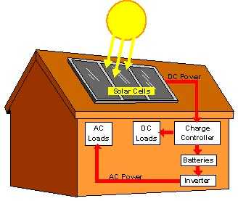
A Solution Component:
Incentivizing Controllable Inverters
PVs are often connected to the grid at the distribution level, where their presence in large scale or volume would be disruptive if not designed, integrated, and managed properly.
Leverage inverters (the power converter circuits that integrate solar PV and battery resources to the grid) as they have:
  Fast power controls and no inherent inertia such that they can respond quickly to commands and local conditions
  Substantial processing and memory resources and are capable of supporting a variety of communication protocols and advanced functions
Expose inverter capabilities and integrate them into utility system operations
  Doing so will facilitate changing PVs from problematic uncertainties to beneficial tools for distribution management

Slide 20
A Solution Component:
Incentivizing Dispatchable Storage
Energy storage is seen as the current “holy grail” in the electric energy domain.
  The ability to store energy in an economic, reliable and safe way and have it available for dispatch to the grid would greatly facilitate the operation of power systems and the integration of renewable energy sources at large scale
  To date high costs and technology limitations have been a barrier to large-scale implementations.
Energy storage would have a significant positive impact on renewable energy source integration:
  frequency regulation
  spinning reserve
  peak load shifting or shaving

Slide 21
A Solution Component:
Incentivizing Dispatchable Microgrids
Microgrid systems would be most beneficial to Ekurhuleni stakeholders when their microgrid management system/controller operates in coordination with an overarching Ekurhuleni DMS.
  The microgrid controllers provide real-time monitoring and control functions for all of the components within their control boundaries.
  The local microgrid controller controls individual components of the microgrid:
    load controllers
    energy storage controllers
    microgneration source controllers.
  Their main objective is to ensure power reliability and quality.
An overall master of multiple microgrid systems allows for optimizing the overall microgrids under its control.
  It defines set points for all the loads and generation in order to optimize the efficiency of the microgrid depending on the electricity prices and local generation cost.
  It also provides forecast and real-time estimation of loads and generation to the DMS.

Slide 22
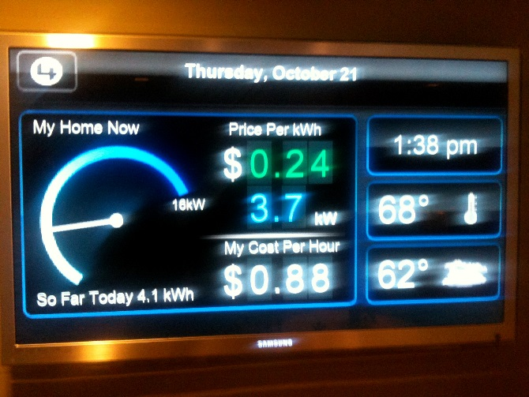
A Solution Component:
Incentivizing Dynamic Pricing
Price signals can be issued in real-time, identifying a price for a given time interval, or based on energy price schedules that are published in advance.
When solar generation makes up a large portion of a region’s generation portfolio, unanticipated changes in cloud cover can unexpectedly change electricity supply
Time-varying rates, and particularly dynamic rates that change hourly based on supply and demand, serve to send a price signal to customers
  Rates rise in concert with supply reductions or increases in demand
  Rates fall in concert with excess supply
  Smart Meter–enabled customer energy management systems can work along with dynamic pricing, automatically managing air conditioning and appliance operation within a customer’s pre-specified instructions as rates rise and fall.
  This helps provide the flexibility required to reliably accommodate greater levels of renewable generation

Slide 23

Locational Constraints Need to be Factored Into Dynamic Pricing
Giving credit on a customer’s power bill 1-for-1 between kilowatt-hours bought versus generated, net metering, is very simple as it assumes that the value of distributed generation equals the utility’s current retail price
  However, it completely ignores all locational differences and scale effects
    It may be a good incentive policy but it is not a particularly accurate price signal
  It also does not pay the utility for the infrastructure it built to in effect be a reliable battery.
Customers will supply some of their own electricity service but will want to buy whatever they cannot self-produce from utility
  However, customers who rely on the Ekurhuleni for all of their supply do not want to subsidize customers who sporadically rely on the electrical network only when they need it

Slide 24
Paving the Way For Dynamic Pricing in the AMI Pilot Project
In addition to being able to support dynamic pricing on a locational basis in the future without having to perform meter change-outs, this pilot project needs to learn information to collaborate with regulators and other stakeholders to optimize the dynamic pricing and demand control.
This pilot will ensure that the technology and backend systems can support these future capabilities without requiring any major change-outs.
Future pilots will leverage this technical capability to understand the degree to which customers respond to variations in pricing structures (i.e., the length of on-peak and off-peak periods, and pricing differentials).
These objectives will require the ability to share meter information with the customer on a near real-time basis and to provide pricing signals to the customer.

Slide 25
Implementing
‘Service Components’
Within a ‘Master Plan’
Ekurhuleni, like most municipalities, needs an incremental “bottom-up” way of building its smart grid:
  The Smart Grid Integration Framework (SGIF) is based on open industry standards
    It enables services-driven automation to be implemented in step with business needs over the 20 year time horizon
    Changes needed for a functional component will have minimal impact on other functional components
    Each service can be owned/leased/operated or outsourced

Slide 26
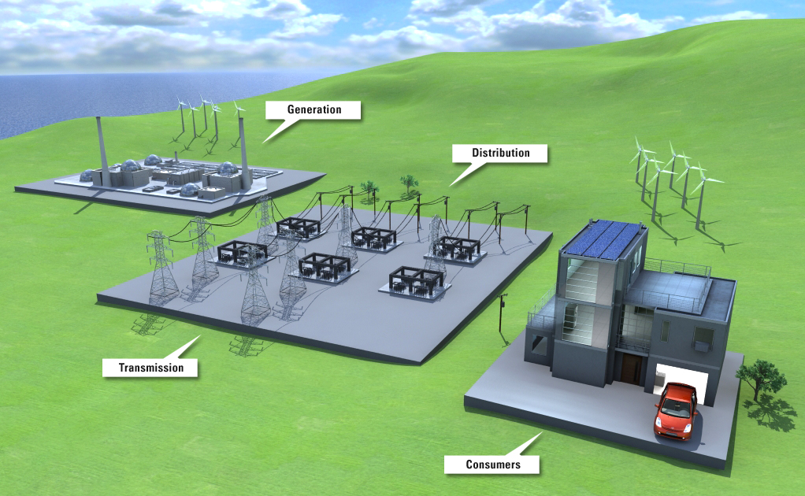
Conclusion
PV is able to provide immediate positive benefit in the form of an off-grid solution to small households awaiting connections
  Especially helpful for informal connections where various types of matters must be resolved before a traditional power connection can be made
PV in the hands of an increasing number of medium and large customers will not be sustainable if “business as usual” continues into future years
Ekurhuleni is embracing renewable energy, but must do so in a thoughtful way.
Ekurhuleni has developed a Smart Grid Roadmap that includes a strategy for embracing PV solutions that will be beneficial to Ekurhuleni, its customers and stakeholders
The first pilot project of the SG Roadmap will:
  Provide smart metering that supports two way communications, including dynamic pricing
  Be based on a flexible services-based integration infrastructure
    The Smart Grid Integration Framework (SGIF) based on not only on open industry protocol standards, but industry standard data models
  Yield useful learning so that Ekurhuleni and its stakeholders can make informed business model adjustment decisions (e.g., propose new tariffs that are sustainable)
Following the Smart Grid Roadmap should enable Ekurhuleni to make investments in the near-term that will continue to be useful in the long-term
  Avoid investing now in what will become a stranded investment later

Slide 27

Final Thoughts
One should take care to match the proposed solution to the expectations of the recipients…
These expectations may sometimes be very different that which logic defines

